Slide 1
INFORMED (HEURISTIC)
SEARCH STRATEGIES
Course Code: CSC4226
Course Title: Artificial Intelligence and Expert System
Dept. of Computer Science
Faculty of Science and Technology
Lecture No: | Four (4) | Week No: | Four (4) | Semester | Summer-2023-24
Lecturer: | Prof. Dr. Firoz Ahmed fahmed@aiub.edu

Slide 2
LECTURE OUTLINE
BEST-FIRST SEARCH
GREEDY BEST-FIRST SEARCH
A* SEARCH
CONDITIONS FOR OPTIMALITY
OPTIMALITY OF A*

Slide 3
INFORMED SEARCH STRATEGY
Informed search strategy—
one that uses problem-specific knowledge beyond the definition of the problem itself
can find solutions more efficiently than can an uninformed strategy.
problem-specific knowledge is the extra bit of information the program uses rather than the problem formulation, thus known as Informed Search

Slide 4
BEST-FIRST SEARCH
The general approach to informed search is called best-first search
Best-first search is an instance of the general TREE-SEARCH or GRAPH-SEARCH algorithm in which a node is selected for expansion based on an evaluation function, f(n).
The evaluation function is construed as a cost estimate, so the node with the lowest evaluation is expanded first
The implementation of best-first graph search is identical to that for uniform-cost search, except for the use of f instead of g to order the priority queue.
The choice of f determines the search strategy.

Slide 5
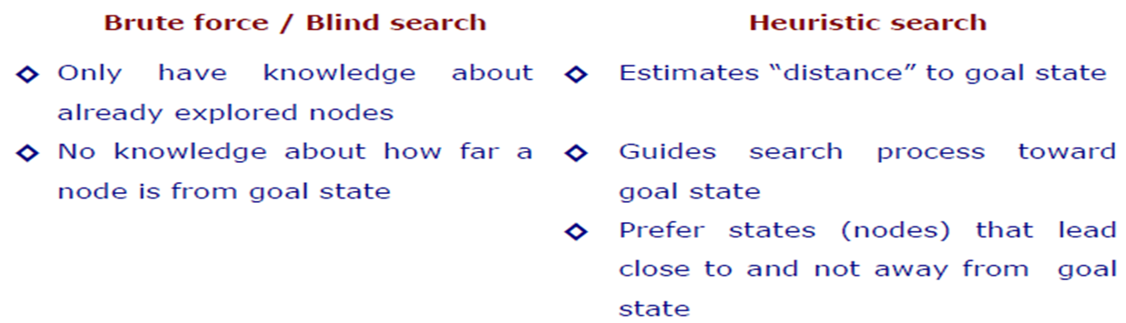
HEURISTIC SEARCH COMPARED
WITH BLIND SEARCH

Slide 6
HEURISTIC FUNCTION
The choice of f(evaluation function) determines the search strategy
Best-first algorithms include as a component of f a heuristic function, denoted h(n)
h(n) = estimated cost of the cheapest path from the state at node n to a goal state.
h(n) takes a node as input, but, unlike g(n), it depends only on the state at that node.
Heuristic functions are the most common form in which additional knowledge of the problem is imparted to the search algorithm
Consider them to be arbitrary, nonnegative, problem-specific functions, with one constraint: if n is a goal node, then h(n)=0.

Slide 7
GREEDY BEST-FIRST SEARCH
Greedy best-first search tries to expand the node that is closest to the goal, on the grounds that this is likely to lead to a solution quickly.
Thus, it evaluates nodes by using just the heuristic function; that is, f(n) = h(n).
“greedy”—at each step it tries to get as close to the goal as it can.
Its search cost is minimal. It is not optimal.
Greedy best-first tree search is also incomplete even in a finite state space, much like depth-first search.

Slide 8
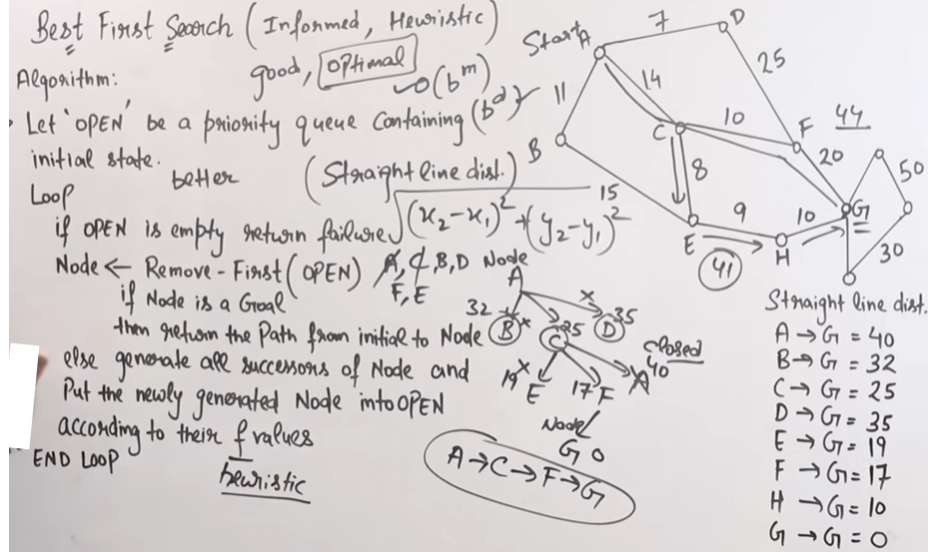
GREEDY BEST-FIRST SEARCH

Slide 9
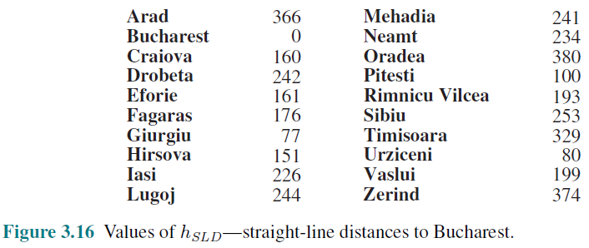
STRAIGHT-LINE DISTANCE HEURISTIC

Slide 10
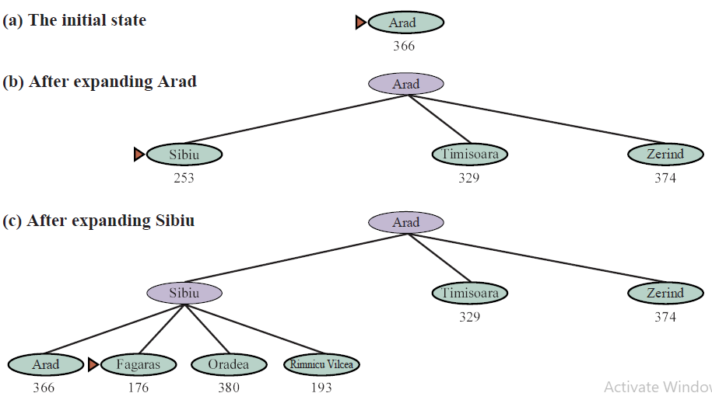
GREEDY BEST-FIRST
TREE SEARCH

Slide 11
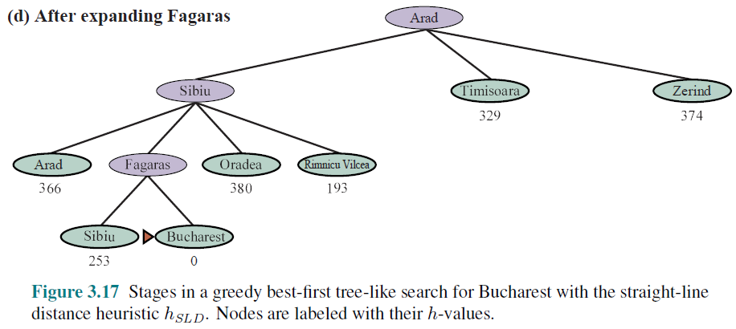
GREEDY BEST-FIRST
TREE SEARCH

Slide 12
A* SEARCH:
MINIMIZING THE TOTAL ESTIMATED SOLUTION COST
The most widely known form of best-first search is called A*search
It evaluates nodes by combining
g(n), the cost to reach the node, and
h(n), the cost to get from the node to the goal:
f(n) = g(n) + h(n) .
Since
g(n) gives the path cost from the start node to node n, and
h(n) is the estimated cost of the cheapest path from n to the goal,
we have f(n) = estimated cost of the cheapest solution through n .
A∗ search is both complete and optimal.
The algorithm is identical to UNIFORM-COST-SEARCH except that
A∗ uses g + h instead of g.

Slide 13
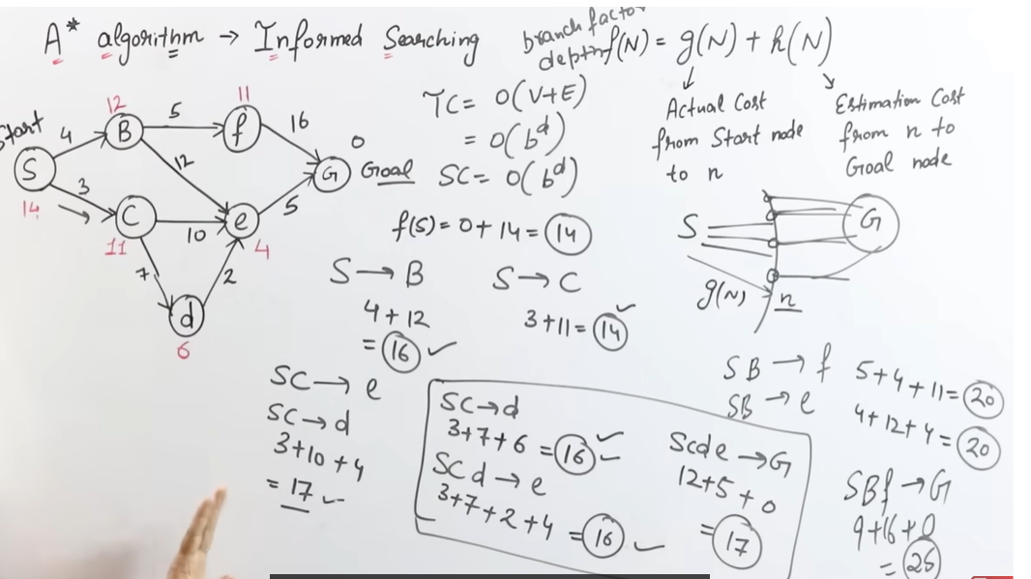
A* Search Algorithm

Slide 14
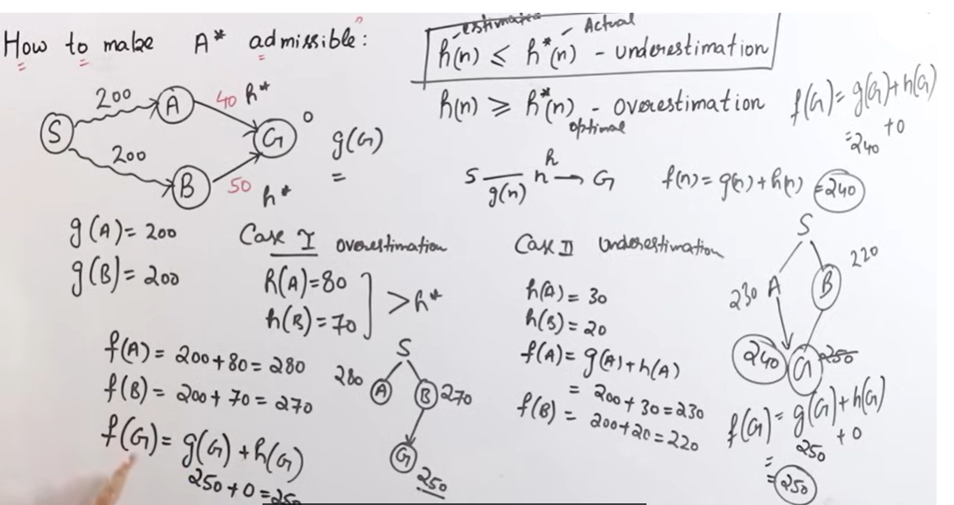
A* Search Algorithm (Admissibility)

Slide 15
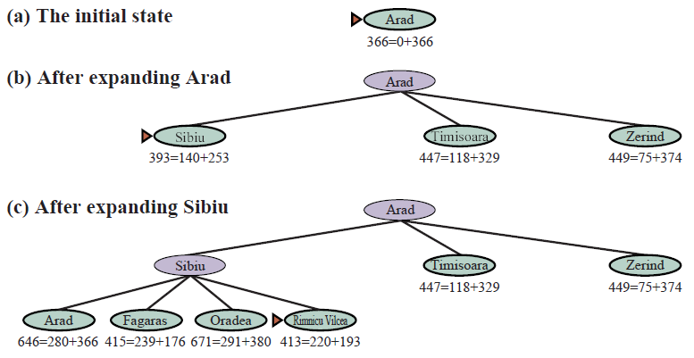
A∗ SEARCH FOR BUCHAREST

Slide 16
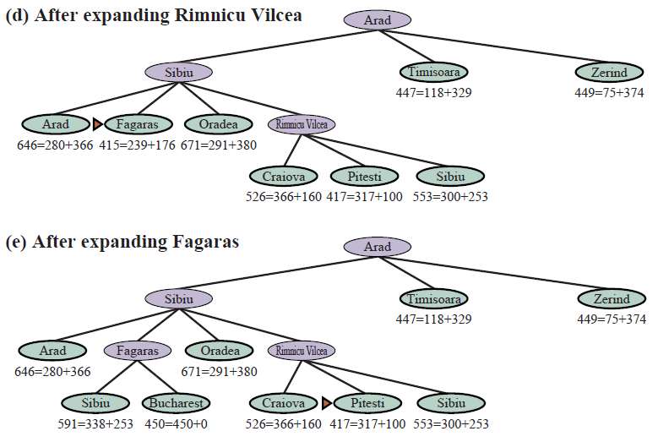
A∗ SEARCH FOR BUCHAREST

Slide 17
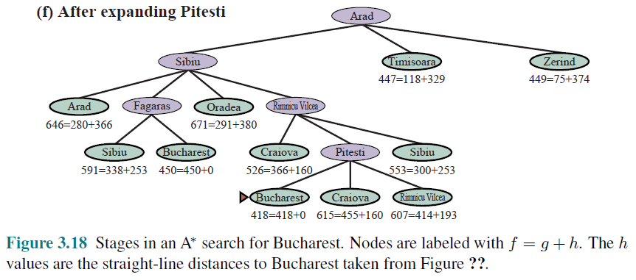
A∗ SEARCH FOR BUCHAREST

Slide 18
CONDITIONS FOR OPTIMALITY: ADMISSIBILITY AND CONSISTENCY
The first condition we require for optimality is that h(n) be an admissible heuristic
An admissible heuristic is one that never overestimates the cost to reach the goal
Because g(n) is the actual cost to reach n along the current path, and f(n)=g(n) + h(n), we have as an immediate consequence that f(n) never overestimates the true cost of a solution along the current path through n.
Admissible heuristics are by nature optimistic because they think the cost of solving the problem is less than it actually is.

Slide 19
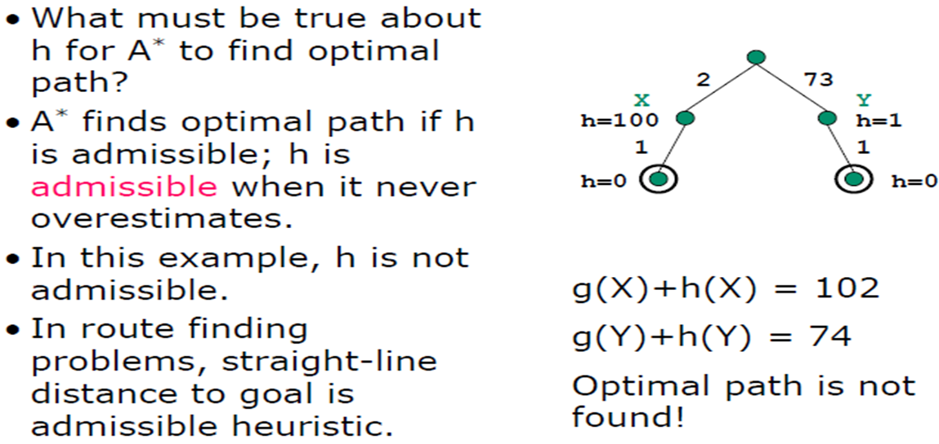
ADMISSIBILITY

Slide 20
CONSISTENCY
A second, slightly stronger condition called consistency (or sometimes monotonicity) is required only for applications of A∗ to graph search.
A heuristic h(n) is consistent if, for every node n and every successor n’ of n generated by any action a, the estimated cost of reaching the goal from n is no greater than the step cost of getting to n’ plus the estimated cost of reaching the goal from n’ :
h(n) ≤ c(n, a, n’) + h(n’).
This is a form of the general triangle inequality, which stipulates that each side of a triangle cannot be longer than the sum of the other two sides

Slide 21
OPTIMALITY OF A*
A∗ has the following properties: the tree-search version of A∗ is optimal if h(n) is admissible, while the graph-search version is optimal if h(n) is consistent.
if h(n) is consistent, then the values of f(n) along any path are nondecreasing.
The proof follows directly from the definition of consistency. Suppose n is a successor of n; then g(n’)=g(n) + c(n, a, n’) for some action a, and we have
f(n’) = g(n’) + h(n’)
= g(n) + c(n, a, n’) + h(n’) because g(n’) = g(n) + c(n, a, n’)
≥ g(n) + h(n) because c(n, a, n’) + h(n’) >= h(n)
= f(n)
So, f(n’) >= f(n)

Slide 22
OPTIMALITY OF A*
The next step is to prove that whenever A∗ selects a node n for expansion, the optimal path to that node has been found. Were this not the case, there would have to be another frontier node n’ on the optimal path from the start node to n; because f is nondecreasing along any path, n’ would have lower f-cost than n and would have been selected first.

Slide 23
Exercise
What is the difference between a Tree Search algorithm and a Graph Search algorithm?
Suppose you are designing a part picking robot that can pick up different machinery parts from a moving conveyor belt, categorize it and place is in its designated bin.
Give PEAS description of the task environment of the part picking robot.
Characterize the agent’s environment as Fully vs. Partially Observable, Deterministic vs. Stochastic, Episodic vs. Sequential and Single vs. Multiagent.
Suppose you want to use A* search to solve the above maze solving problem. What can be used as an admissible heuristic function?

Slide 24
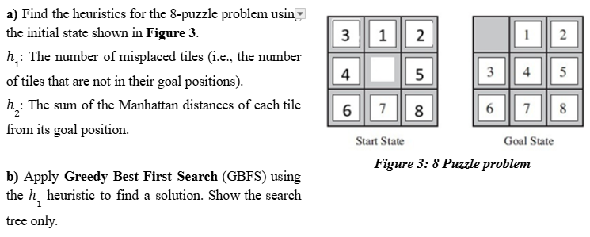
Exercise

Slide 25
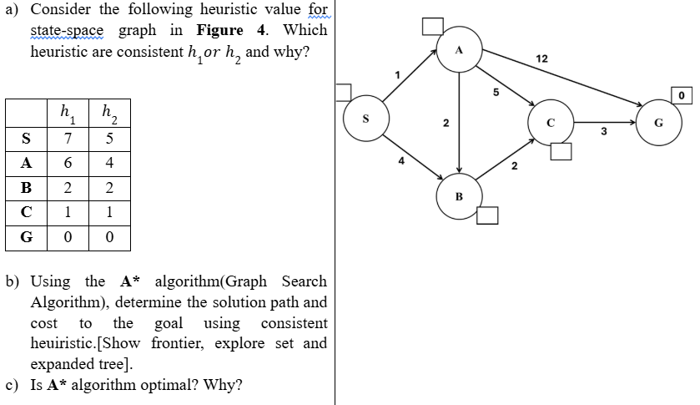
Exercise

Slide 26
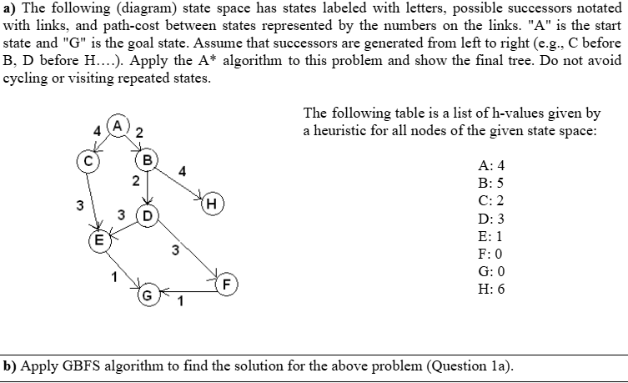
Exercise

Slide 27
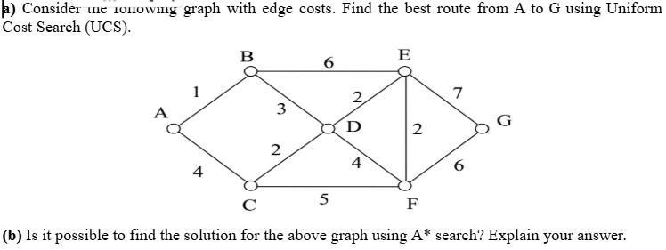
Exercise

Slide 28
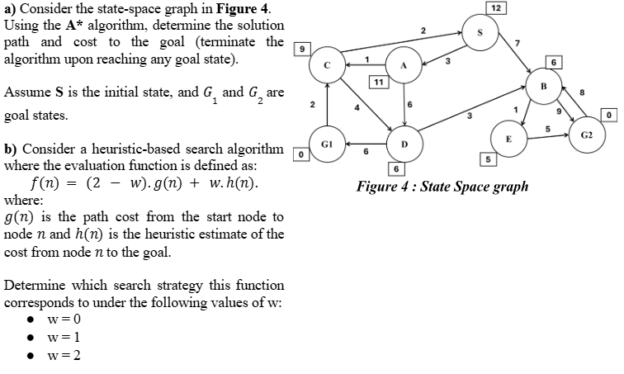
Exercise

Slide 29
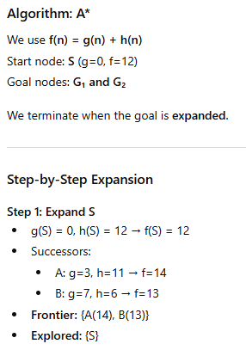
Solution

Slide 30
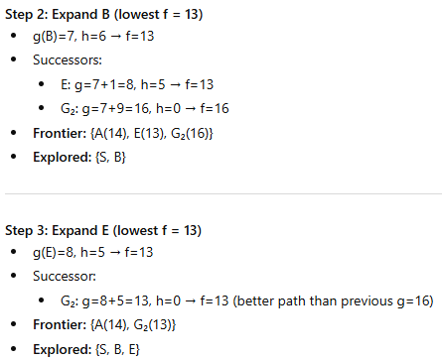
Solution

Slide 31
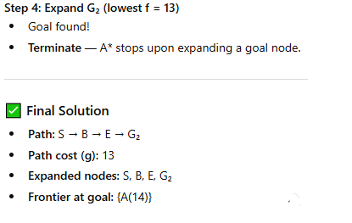
Solution

Slide 32
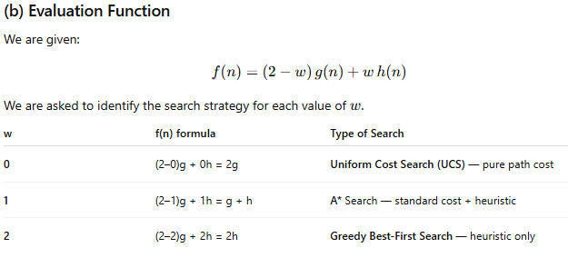
Solution

Slide 33
Exercise

Slide 34
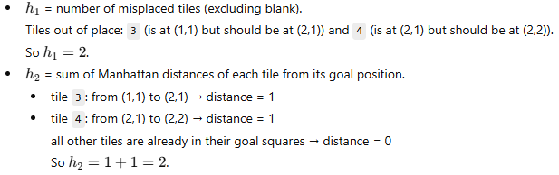
Solution

Slide 35
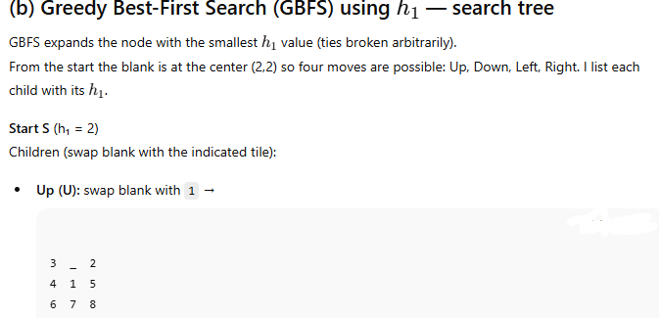
Solution

Slide 36
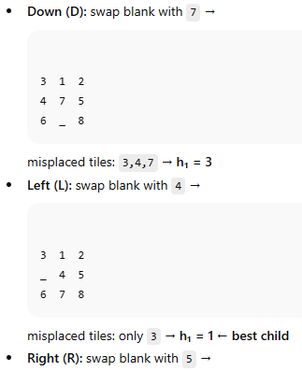
Solution

Slide 37
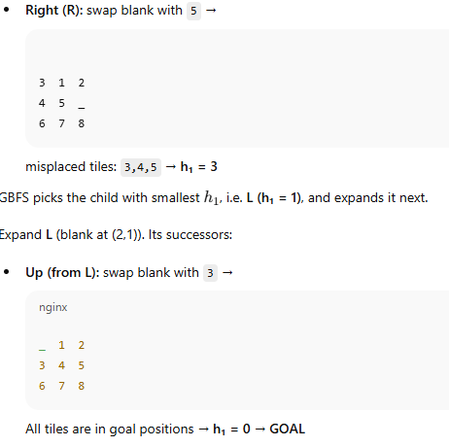
Solution

Slide 38
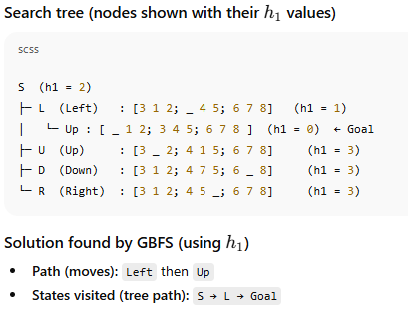
Solution

